Slide 1
THE PLAN
INTRODUCTIONS
NEW COMMUNITY VISIONS INITIATIVE
THEORY OF IMPACT
FINDINGS
Q&A

Slide 2
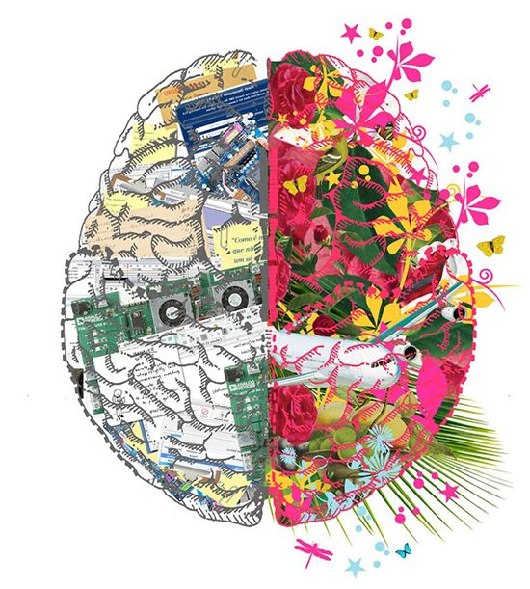
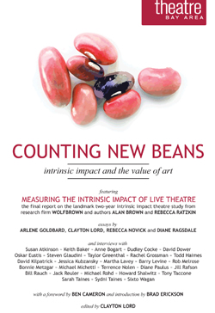
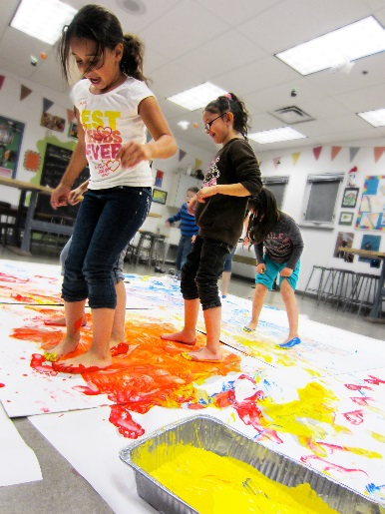
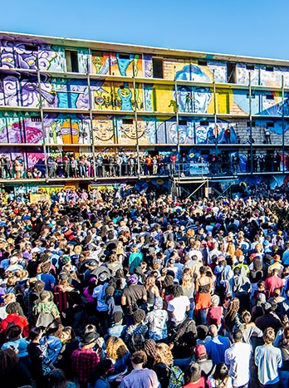

Physical
Individual
Interpersonal
Community

Slide 3
350,000,000 people in the U.S.
100,000 arts and culture non-profits
700,000 arts industry businesses
4,500 local arts agencies
2,900,000 creative workers
95% makes or consumes culture in some way
35% attend traditional place-based arts experiences
TODAY

Slide 4










TODAY
Economic Development
Public Safety
Budgets
Infrastructure
Education
Housing
Energy/Environment
Demographics
Technology and Data
Health Care
100 Resilient Cities: “The 10 Most Important Issues Facing Cities, According To Their Mayors,” July 2016

Slide 5
?
*
WHAT
ABOUT
THE ARTS
*(not hypothetical)

Slide 6



NEW COMMUNITY VISIONS

Slide 7
1) TO UNDERSTAND THE RELEVANCE OF THE ARTS IN COMMUNITY LIFE.
GOALS
2) TO UNDERSTAND WHETHER INTERMEDIARIES LIKE LAAs CONTINUE TO HAVE VALUE.

Slide 8
QUESTIONS
1) WHAT IS YOUR VISION FOR A HEALTHY, VIBRANT, EQUITABLE COMMUNITY?
2) WHAT DO “HEALTH,” “VIBRANCY,” “EQUITY,” AND “COMMUNITY MEAN?
3) WHAT IS THE ROLE OF ARTS AND CULTURE IN ACHIEVING THAT VISION?
4) WHAT ROLE, IF ANY, SHOULD AN INTERMEDIARY/NEXUS ORGANIZATION PLAY?

Slide 9
AGENCIES
ARTISTS
ARTS ORGANIZATIONS
EQUITY
COMMUNITY
HEALTH
VIBRANCY
LOCAL BUSINESS
RESIDENTS
GOVERNMENT
PHILANTHROPY

Slide 10
Who are you? What do we care about?
What is your relationship to, and the future of, your changing place—what has you worried?
What do “community,” “equity,” “healthy,” and “vibrant” mean to you?
When you think about a challenge your community can overcome, what are the barriers/capacities/resources? Why hasn’t it been overcome?
What’s the role of arts and culture?

Slide 11
Who are you? What do we care about?
Venture capitalist artist. Administrator artist. Parent. Multi-faceted people. People without enough time. People whose work is our calling. People with deep histories inside and outside the arts. People who attempt to balance bureaucracy. Travelers. Intergenerational. People who love the outdoors. Immigrants. Hard workers. Faithful, passionate people. People who like wearing multiple hats. People rooted in the community. We care about journeys. We plant seeds in the ground. We are resilient.

Slide 12
What is your relationship to, and the future of, your changing place—what has you worried?
Complicated. People think they want change, but tend toward stability. Change comes in big ways and small ways. Nurture the parts that work to fix the parts that don’t. My place is not homogeneous. Place is personal, but is also organizational and situational. Place is people. Place is a function of time and the moment. We’re all trying to change—and keep—the place we live. Place is a sense of belonging—you can feel out of place in a place that has changed around you. Change is something you make happen/change is something that happens to you. Place is about food, energy, people, and faith. Gentrification, environmentalism, violence, demography.

Slide 13
What does “community” mean to you?
Does “community” embody authentic connection? What are your hidden assumptions? How do you account for the changing of community? Who creates/defines community? Can you be part of a community without wanting to? Why are we making community? How do we prevent community building from creating exclusivity? How accessible is a community? Are you identifying others as a community—and do they agree? What is your investment in community? How do you recognize when you’re at a point of intersecting communities? Are you serving or shaping? Does community perpetuate an inequitable system of power? Who is in and who is out? Who is defining the vision of a “better” community? Where do you feel you belong?

Slide 14
What does “equity” mean to you?
Do you have the skill set to build equity? Can you and your privilege get out of the way? Is equity a process or an outcome, or both? How can we ensure we aren’t overlooking those who have been chronically overlooked? How do we find the internal/ invisible barriers within us? How do you deal with the inequity of having the power to pursue equity? Is equity just a word you’re using to not-say diversity? What would signify success for you? When pursuing an equitable community, have to talked to the community? Are you willing to tackle the system or just the problem? How do you know the difference? How can you guarantee “guaranteed opportunity?” How do “failure” and “success” change in an equitable environment? How do you acknowledge the trauma that has preceded the effort?

Slide 15
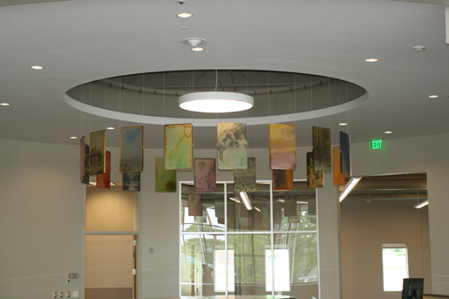
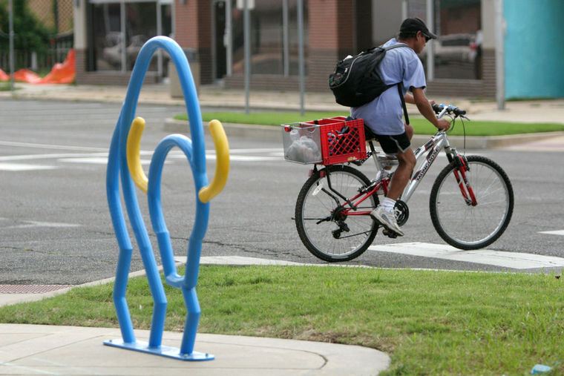
When you think about a challenge your community can overcome, what are the barriers/capacities/resources? Why hasn’t it been overcome?

Slide 16
What’s the role of arts and culture?

Slide 17
IDEAS
SYSTEMS
GAPS
LEADERS

Slide 18
HEALTHIER, MORE VIBRANT, MORE EQUITABLE COMMUNITIES
ARTS AND…

Slide 19

WHEN FULLY INTEGRATED, THE ARTS CAN…
TRANSFORM SYSTEMS by working at the intersections | IMPACT IMPACTS by amplifying positive and mitigating negative outcomes | INCREASE PARTICIPATION & OPPORTUNITY by reducing barriers and celebrating multiple points of view

Slide 20
HOW ARTS INTERMEDIARIES DO THEIR WORK
ADVOCACY & POLICY
FACILITIES
1
2
3
4
5
6
7
FUNDING & FINANCING
VISIBILITY
Partnerships & PLANNING
SERVICES
PROGRAMS & EVENTS

Slide 21

+
+
➔

Slide 22
THE SHIFTING RELATIONSHIP BETWEEN ARTS, CULTURE, AND COMMUNITIES

Slide 23
Cultural Expression. What your community considers art may be shifting.
Community Orientation. The size and make-up of the group you serve continues to change.

Slide 24
Engagement. The mandate to “engage” now extends beyond a memorable cultural experience.
Partnership. With cross-sector cooperation at the forefront of many minds, the ability to facilitate partnerships can be crucial.

Slide 25
THE CHANGING ARTS/COMMUNITY RELATIONSHIP

Slide 26
THE CHANGING ARTS/COMMUNITY RELATIONSHIP
Economics. Changes in funding can be a challenge for nexus organizations as communities re-examine their priorities, resources, and goals.

Slide 27
THE CHANGING ARTS/COMMUNITY RELATIONSHIP
Investment. The underwriting of artists and organizations is transforming.

Slide 28
THE CHANGING ARTS/COMMUNITY RELATIONSHIP
Demographics and Equity. Residents have new expectations for equity as demographics shift.

Slide 29
THE CHANGING ARTS/COMMUNITY RELATIONSHIP
CAPACITY. As the scope of work expands, the skills, time allocations, and job descriptions of those working may need to shift or expand.

Slide 30
THE CHANGING ARTS/COMMUNITY RELATIONSHIP
Advocacy and COMMUNICATIONS. In a crowded landscape that has always been a challenge for the arts, advocacy and communication are continuously cited as core needs.

Slide 31
THE CHANGING ARTS/COMMUNITY RELATIONSHIP
Data and Metrics. Community members, policymakers, and funders want to know the data-backed impact of investments they make, knowing how to share your value metrics is crucial.

Slide 32
1) WHAT IS THE RELEVANCE OF THE ARTS IN COMMUNITY LIFE?
GOALS
2) DO INTERMEDIARIES LIKE LAAs CONTINUE TO HAVE VALUE?

Slide 33
BIG QUESTIONS AND CHALLENGES

Slide 34
QUESTIONS & CHALLENGES
Who is dictating the role of arts and culture in the U.S., and does that align with what we’re telling and teaching ourselves?

Slide 35
QUESTIONS & CHALLENGES
How can we better deal with the capacity/skills/ resources gaps that exist in relation to arts based community development?

Slide 36
QUESTIONS & CHALLENGES
Where are the arts and artists in the ongoing conversation about communities?

Slide 37
QUESTIONS & CHALLENGES
What are the characteristics of “fertile ground” that will allow the arts to flourish in a way that is true to the needs/desires of U.S. communities?

Slide 38
QUESTIONS & CHALLENGES
How do you deal with an outcomes- and data-driven world in a moment when much of our work is not easily held up to metrics?

Slide 39
QUESTIONS & CHALLENGES
What business are we in?
What are our values?
Where can we make a difference?

Slide 40
What resonates?
What doesn’t?
What’s missing?

